Slide 1
Unrolled gan

Slide 2
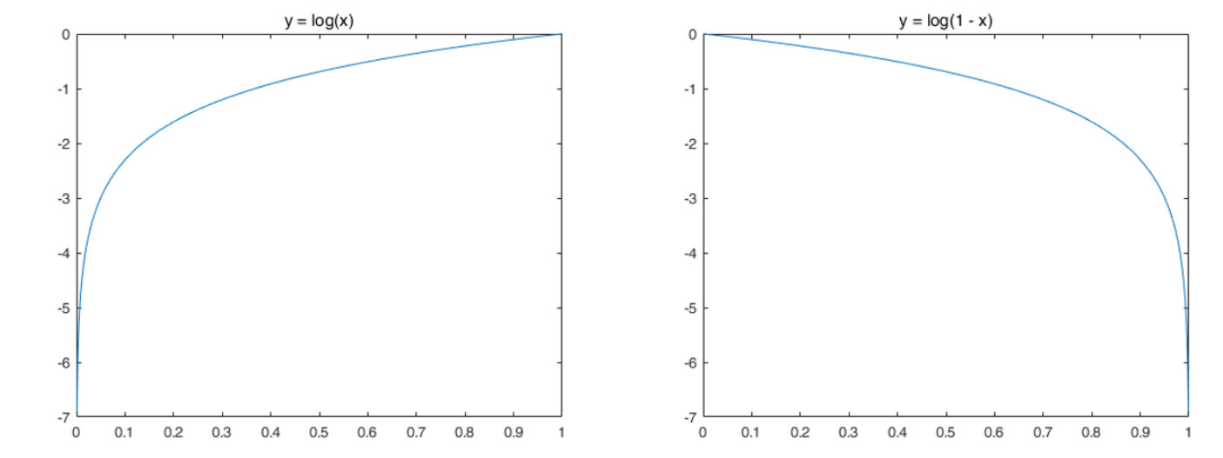
using the optimal discriminator(in the generator’s objectives) impossible
k steps of optimizing D and one step of optimizing G
D: near optimal solution
G: change slowly enough
x: data variable , z: noise variable, G(z): fake data

Slide 3
Unstability of gan
Mode collapsing or dropping (generator)
Generator and discriminator oscillating during training
No learning when the power between generator and discriminator is unbalanced.

Slide 4
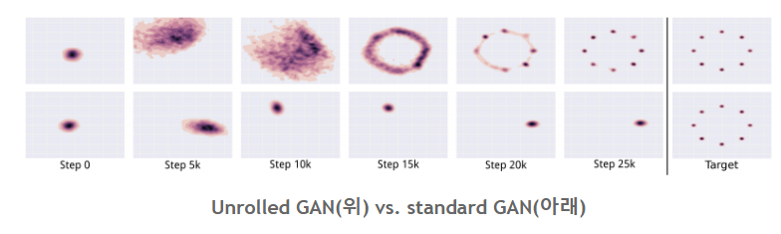



Mode collapsing

Slide 5
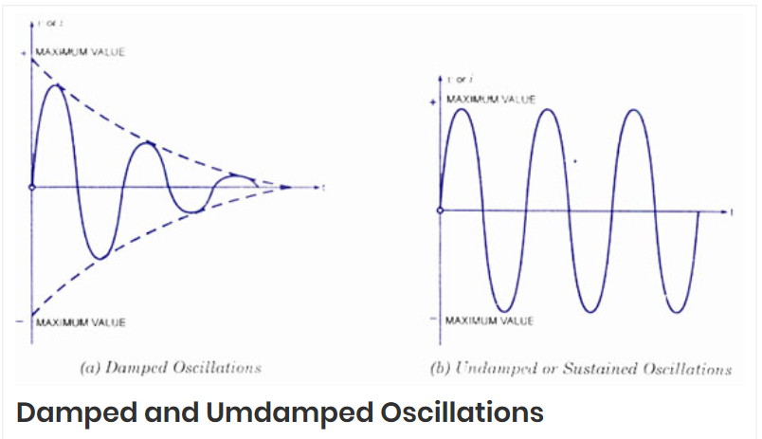
Undamped oscillation

Slide 6


f (θG,θD) is typically very far from convex in θG and concavein θD
$$f\left(θ_{G},θ_{D}\right)=$$
D
G
Not concavein
Not convex
impossible

Slide 7

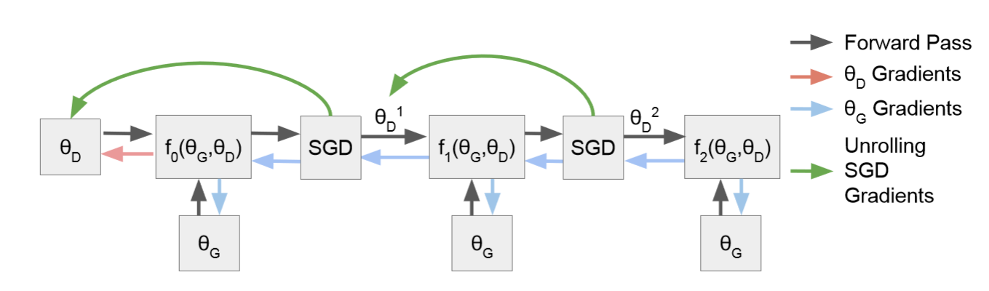
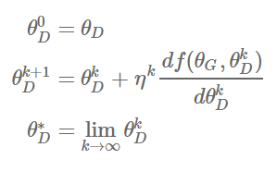
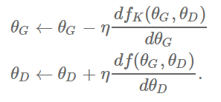


we will introduce a surrogate objective function fK (θG,θD)
Surrogate objective funtion
Local optimum $θ_{D}^{∗}$
Update
$θ_{D} 업데이트에$는 $f_{k}를$ 적용하지 않는다

Slide 8


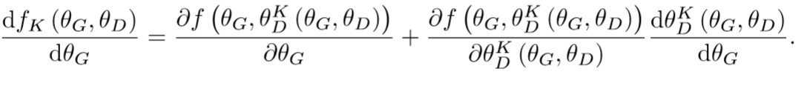
What is different from standard gan?
Standard gan: several update steps of the discriminator parameters should be run before each single update step for the generator
unrolled gan: several update steps of the discriminator parameters should be run before each single update step for the generator

Slide 9
the second term reﬂects that as the generator collapses towards a delta function
Delta function: An optimal generator for any ﬁxed discriminator

Slide 10
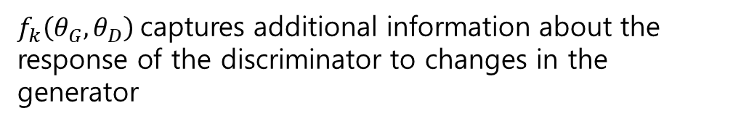



When K = 0 and when K → ∞ : standard Gan loss = unrolled gan loss
K = 0
K = $∞$
$f_{0}\left(θ_{G},θ_{D}\right)=f\left(θ_{G},θ_{D}^{0} \right)$ = $f\left(θ_{G},θ_{D}\right)$
$f_{∞}\left(θ_{G},θ_{D}\right)=f\left(θ_{G},θ_{D}^{∞} \right)$ = $f\left(θ_{G},θ_{D}^{∗} \right)$
K=1,2,3, ……
$f_{k}\left(θ_{G},θ_{D}\right)$captures additional information about the response of the discriminator to changes in the generator

